Slide 1

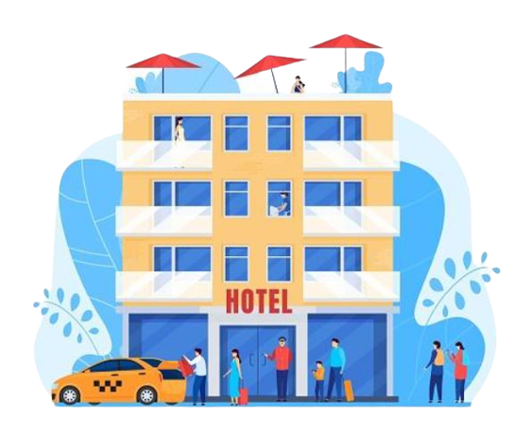
FutureTale Hotel Reservation
Reservation cancellation analysis
Group 5

Slide 2
What is the Problem?
You have been employed as a Data Scientist to explore the data and provide some insights and recommendations?
KEY TASKS
Provide Insights & Analytical information from the date on the factors influencing the cancellations of Hotel Reservations
Investigate the Impact of Online Hotel Booking Channels viz-a-viz Ease of cancellations
Review the impact of cancellations on Revenues
Make recommendations

Slide 3
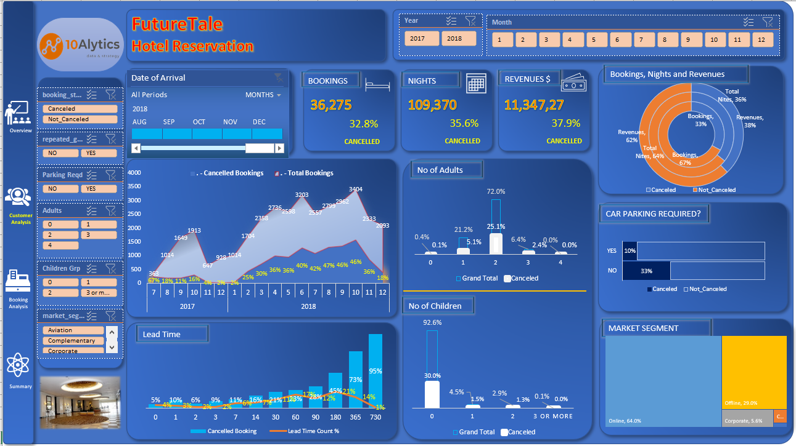
Notes:
There is an upward growth trend in the bookings across the entire period of the data set.
Also there is a corrresponding growth in the cancellation, thus calling for attention to address the root cause, thereby optimising the business operations and efficiencies.
There is an unsual seasonal decline in bookings towards the end of the year though there was a seasonal decline in cancellations.
Efforts at increasing the Bookings is being eroded by cancellations.
Major contributor to this cancellations under Customer Analysis are:
Repeated guests: Less than 2% of the guests are repeated guests. Why? Any reason there are no repeated guests?
No of Adults: 2 adults are commost. Sounds more like a honeymoon resort. Or hotel that attracts couples more.
No of children: Most guests do not come with children. Guests without children accounts for about 93%
Market Segment: Online clients account for 64% of total bookings and most of the cancellations
Lead Time: Cancellation rate increases for lead times greater than 7days
Car park required: Guests requiring Car parking seldom cancel their bookings compared with guests without car parking requirement. This is 10% vs 33%

Slide 4
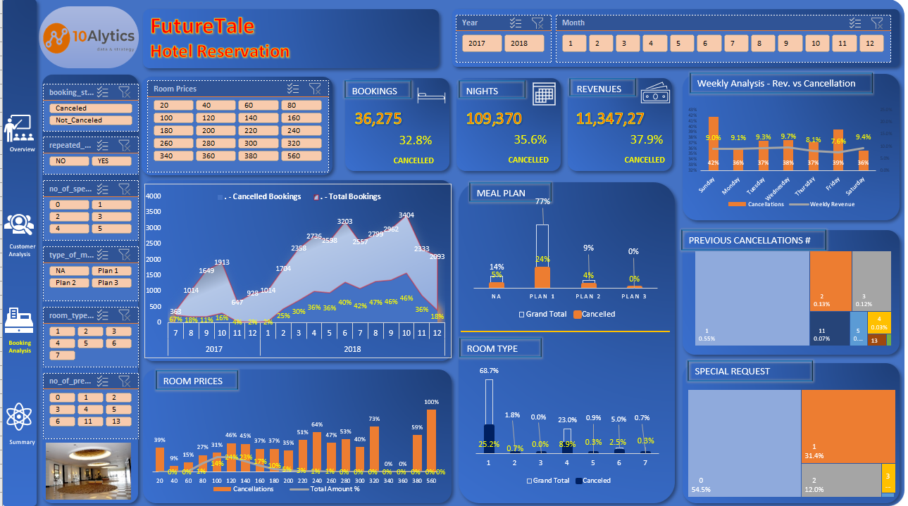
Notes:
There is an upward growth trend in the bookings across the entire period of the data set.
Also there is a corrresponding growth in the cancellation, thus calling for attention to address the root cause, thereby optimising the business operations and efficiencies.
There is an unsual seasonal decline in bookings towards the end of the year though there was a seasonal decline in cancellations.
Efforts at increasing the Bookings is being eroded by cancellations.
Major contributor to this cancellations under the BOOKING ANALYSIS are:
Room Prices: $60-$200 accounts for over 90% of total bookings. The room prices are highly skewed to the right. Almost no one patronizes room prices over USD250
Room Types: Type 1 & 4 accounts for over 90% of total bookings
Meal Plan: Plan 3 is almost not needed on the plan. Perhaps the hotel should replace with some other plan
Day of the Week for Arrival: Fridays and Thursdays are below average for booking volumes
Special requests: Over 54% of the clients don’t have any special request. And 85% have 1 or less special requests

Slide 5
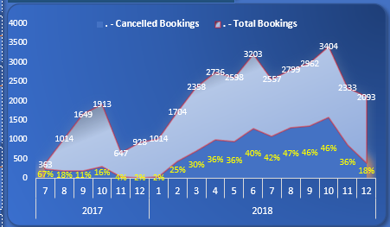

Summary
Bookings
Revenue
TRENDS:
Increase in Bookings is accompanied with a growing rate of cancellations
Every cancelled booking translates to lost revenues with a multiplier effect
An unsual seasonal decline in bookings towards the end of each year. This positively correlates with the seasonal decline in cancellations
The Room Prices is largely skewed to the right with over 90% of bookings within $80 - $200 price range
Major contributor to this cancellations are:
Room Types
Repeat guests
No of Adults
No of children
Market Segment
Lead Time
Room Prices
Meal Plan
Day of the Week for Arrival,
Car park required
Special requests

Slide 6
RECOMMENDATIONS
MARKET SEGMENT:
Online segment of the clients contribute 64% of the total bookings but has over 40% cancellation rates.
Efforts should target reducing the cancellation of online booking.
Also, increased marketing efforts to targets that accommodate the cancellations.
BOOKINGS, NIGHTS & REVENUES:
Every cancelled booking translates to multiple nights cancelled and eventually translates to corresponding revenue losses.
-Investigate every cancelled booking and put up action plans to enable the business optimize their operations
Recommendations:
-Increase marketing efforts to make up for the possible cancellations which is approximately 33%
-Optimize room pricing strategy, especially the luxury rooms
-Special focus on repeat customers as these rarely cancel bookings
-Put measures (discounts for prompt payment, cancellation charge) in place to discourage cancellation of bookings with longer lead times
-Online payments should require deposit payments to confirm booking as a discouragement for cancellation
ROOM TYPE:
2 Room types (#1 & #4) make up 91% of the bookings. Rooms 6 & 7 contribute about 6% of total bookings but they have about 50% cancellations rate.
Need for initiatives to promote bookings for the rooms and investigate reasons for high cancellations on Rooms 6 & 7.
DAY OF THE WEEK:
Weekly Summary shows that Wednesdays has the highest revenue while Fridays have the least.
-Create incentives, complimentary bookings and special offers to promote business volumes on Fridays and also to reduce Cancellations on Sundays and Fridays
NO OF ADULTS:
72% of the bookings are for 2 adults while 21% is for single adult. This could connote that most of the bookings are for couples.
Explore initiatives to reduce the high rate of cancellations for bookings for 2 adults. Also, promote bookings for single adults from the corporate segment.
ROOM PRICES:
The distribution of bookings is highly skewed to the right with the Room Prices. Also note that Cancellations is higher with rooms with prices greater than $200
Optimisation of the pricings for room types by proffering discounts for luxury rooms with corresponding penalty for cancellations

